Slide 1
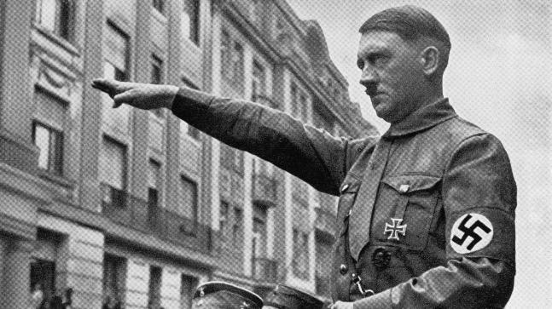
Nazi Society: Creating the volksgemeinschaft
Hitler as a dictator
Nazi Youth
Dissent - Edelweiss Pirates and Swing Youth
Women - the family and Nazi dogma
Mothers of the Reich
Strength Through Joy
Propaganda - Goebbels
The Media and the Arts

Slide 2
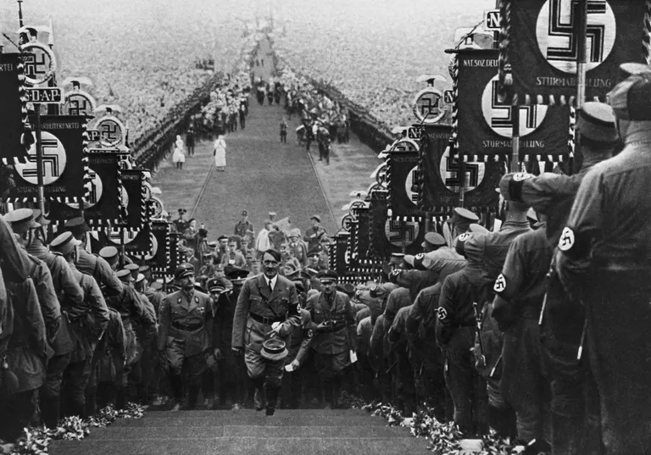
Volksgemeinschaft
Volk = people
Volksgemeinschaft = Peoples’ Community
Nazi ideology
Rejected old religions, ideologies, and class divisions, instead forming a united German identity based around ideas of race, struggle, and state leadership.

Slide 3
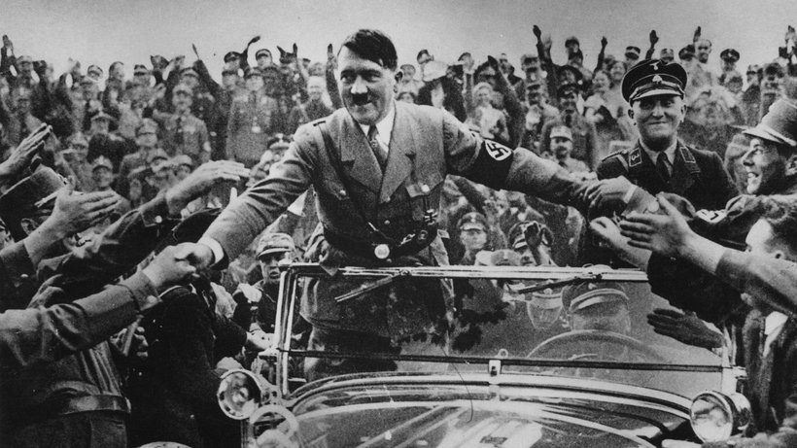
Hitler as a dictator
2nd August 1934, two weeks after the Night of the Long Knives, President Hindenburg died.
Hitler declared himself President.
Now Chancellor, President, Head of State and Commander of the Army.
Every soldier swore an oath of loyalty to Hitler himself.

Slide 4
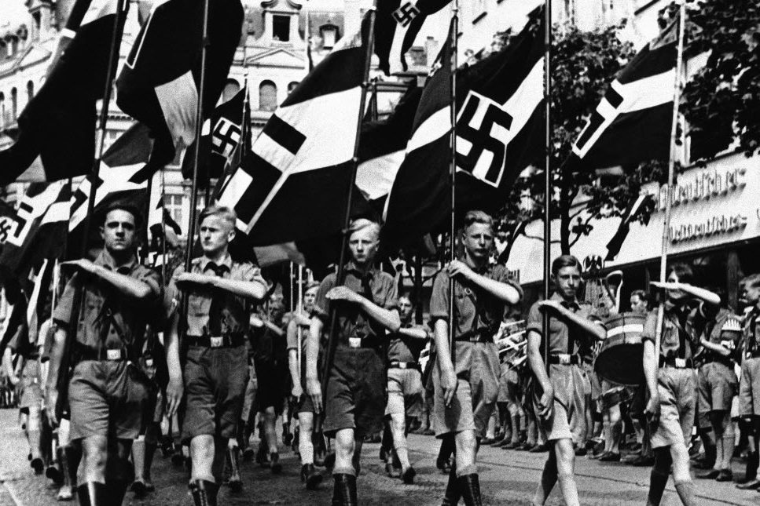
Nazi youth
Aimed to indoctrinate.
Nazi Youth an organisation for children.
Hitler Youth for boys.
League of German Maidens for girls.

Slide 5
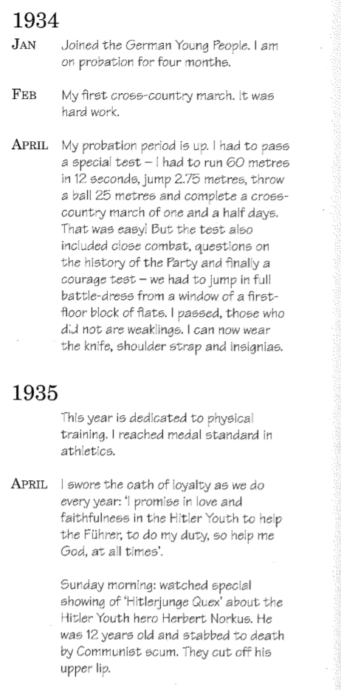
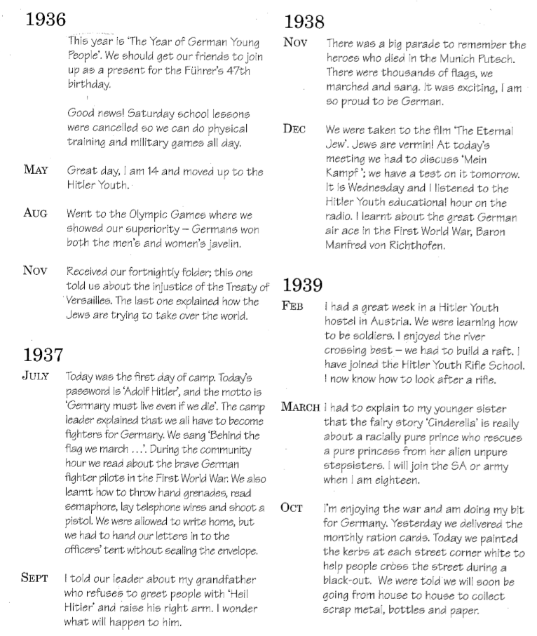

Slide 6
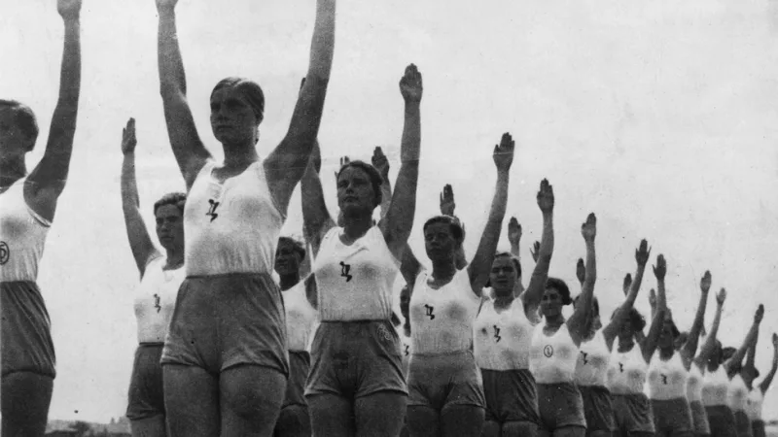
Women - the family and Nazi dogma
Nazis believed women had different roles to men.
Women should be in the home producing children.
Women should be mothers.
Encouraged to stop smoking, stop slimming and do sport.
Women not allowed in the workforce…until 1939…

Slide 7
“Woman has her battlefield too; with each child that she brings into the world for the nation she is fighting her fight on behalf of the nation.”
-Hitler, speaking in 1934 at the Reich Party Conference

Slide 8
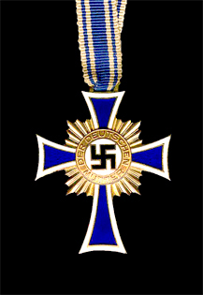
Mothers of the Reich
‘The Honour Cross of the German Mother’
Gold for 8 children
Silver for 6 children
Bronze for 4 children

Slide 9
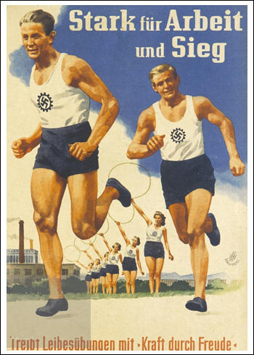
Strength Through Joy
(Kraft durch Freude)
Set up in Nazi Germany so that all aspects of a worker’s non-working time were looked after.
Supervised after-work activities, holidays and leisure time.
Two main purposes:
to ensure that no one had too much time on their hands to get involved in untoward activities against the state.
to produce an environment within Nazi Germany whereby the average worker would be grateful to the state for providing activities and holidays that in ‘normal’ circumstances they could not afford as individuals.

Slide 10
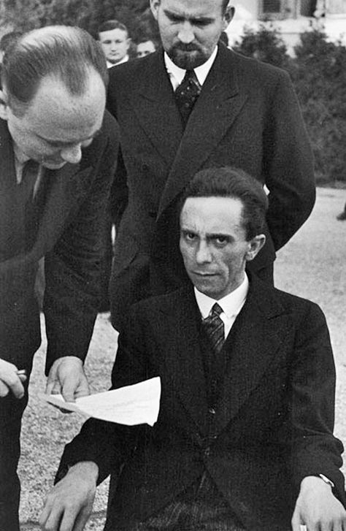
Propaganda and censorship - Goebbels
Josef Goebbels – Nazi Minister for Propaganda and National Enlightenment
Controlled newspapers
Films
Radio
Festivals and celebrations

Slide 11
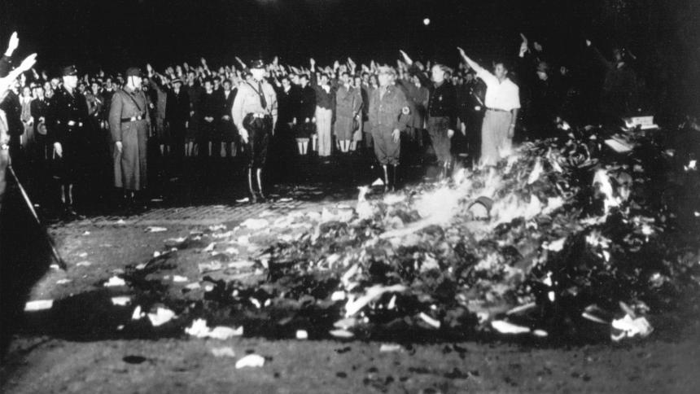
May 10, 1933
Joseph Goebbels speaks at book burning in Berlin
Forty thousand people gather to hear German propaganda minister Joseph Goebbels speak in Berlin's Opera Square. Goebbels condemns works written by Jews, liberals, leftists, pacifists, foreigners, and others as "un-German." Nazi students begin burning books. Libraries across Germany are purged of "censored" books. Goebbels proclaims the "cleansing of the German spirit."

Slide 12
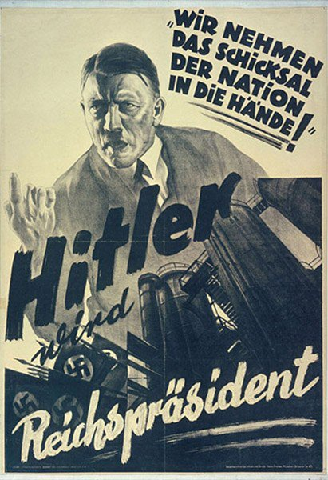
This Nazi propaganda poster comes from Adolf Hitler's campaign to become Germany's supreme leader. The text reads, "We will take the fate of the nation into our hands! Hitler will be Reich President!"

Slide 13
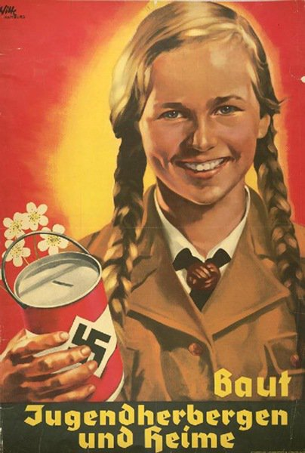
In this Nazi fundraising poster, a member of the Hitler youth asks for money to build youth hostels and homes.

Slide 14
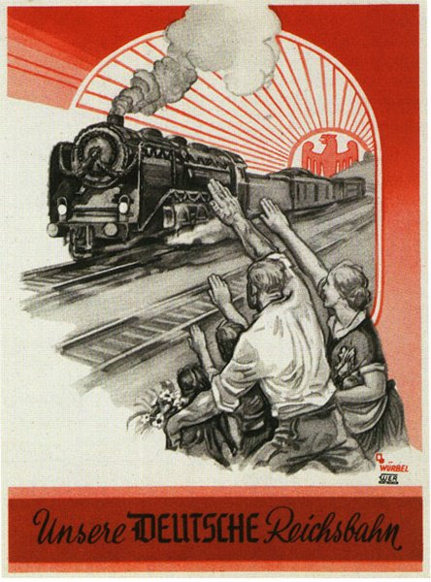
A German family salutes the German Imperial Railroad.

Slide 15
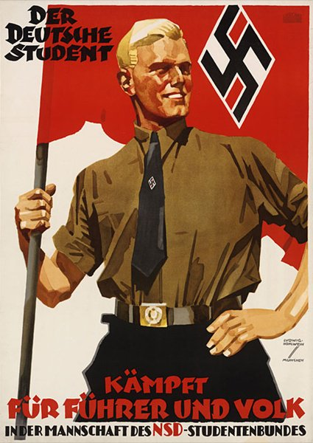
Here, a patriotic member of the Hitler Youth poses with the flag of the Nazi party. The text reads, "German students fight for the Fuhrer and the people."

Slide 16
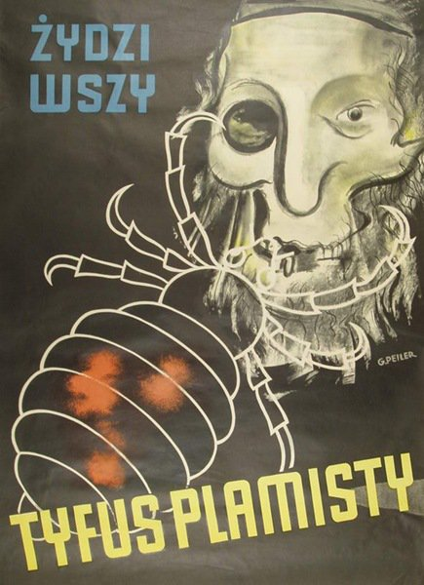
This poster, which reads "Jews are lice," was plastered across Poland, spreading fear that Jewish people carried typhus.

Slide 17
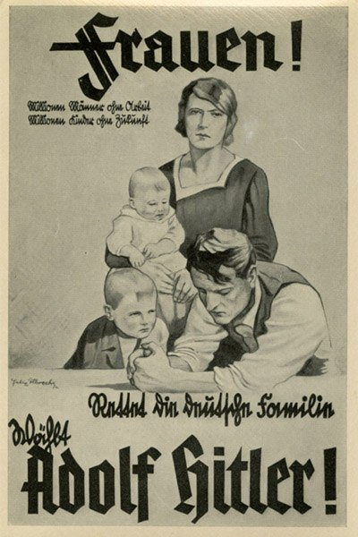
This poster tells German women to protect their families by voting for Hitler.

Slide 18
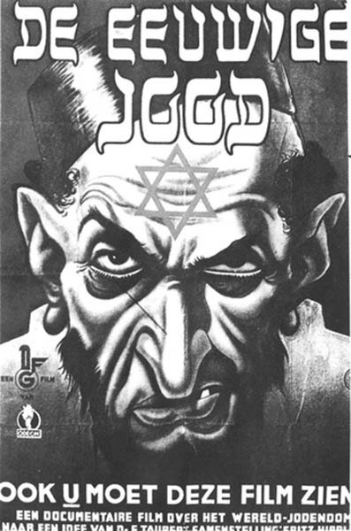
This is a poster for a film called the The Eternal Jew. The film was marketed as a documentary and depicted the Jewish people as manipulative and uncivilized.

Slide 19
The Media and the Arts
Art
Great Exhibition of German Art, showcasing recent leading examples of "Aryan" art.
Entartete Kunst (Degenerate Art) Exhibition, which offered a tour through the art that the National Socialist Party had rejected on ideological grounds. It was made up of art that was not considered "Aryan" and offered a last glimpse before these works of art disappeared.
Literature
Listed banned books
Goebbels wanted books about race, war and the Nazi movement
Music
Goebbels drew up guidelines for what music was acceptable
Films
Goebbels encouraged new films
Cinema popular
Propaganda films
Jud Suss (evil Jew)
Triumph of the Will (Leni Riefenstahl)

Slide 20
Dissent - Edelweiss Pirates and Swing Youth
Youth protest movements did exist in Nazi Germany.
In 1937 the Edelweiss Pirates (Eidelweisspiraten) movement started.
Mainly working class male youths.
They would gather together and act in a manner that they would know would anger the local Nazi leaders.
Edelweiss members wore more bohemian clothing.
Youths from more upper class backgrounds formed ‘swing groups’.
Engaged in what would have been perceived as non-Germanic activities.
White Rose movement founded by Hans and Sophie Scholl.
Members of this movement openly campaigned against Hitler and the continuation of World War Two.

Slide 21
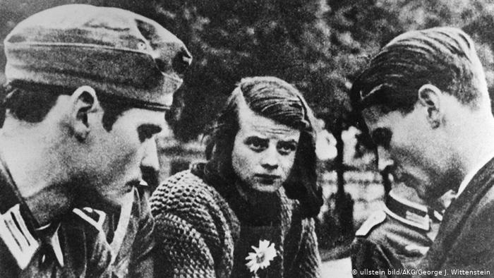
Sophie and Han Scholl

